Slide 1
Best Practices For Utilizing Dynatrace On Your Mobile Apps
Dynatrace Perform 2020, Las Vegas

Slide 2
Prerequisites
Remote Desktop Protocol (RDP) Client

Slide 3
The hands-on environment
Genymotion SaaS
5. Set up Genymotion
1. Connect to the VM
Deploy app
Mobile apps
Windows VM
Development tools
Your laptop
Mobile backend
RDP
Chrome
RUM beacon
easyTravel backend and load generator
Dynatrace tenant
2. Git Clone the HotDay Repo
OneAgent
3. Log in to Dynatrace and install OneAgent on the VM
4. Start easyTravel
PurePaths and demo data

Slide 4
Download the app
Run the following command in Cmder
cd c:\
git clone https://github.com/Dynatrace/perform-2020-hotday.git

Slide 5
Demo App Prep Work
Download OneAgent on the Windows Machine
Edit EasyTravel configuration
Directory
C:\Program Files\dynaTrace\easyTravel (x64)\resources
File
easyTravelConfig.properties
Start EasyTravel and launch the Standard Scenario

Slide 6
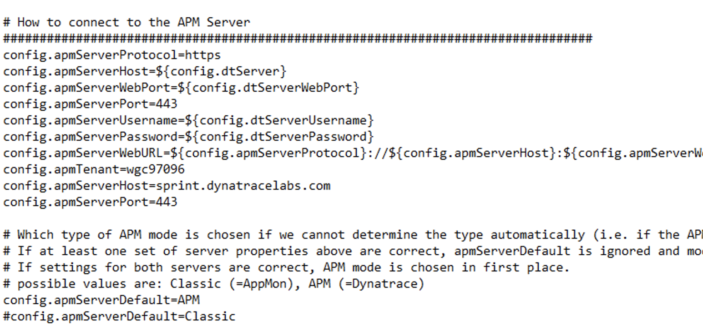
easyTravel backend and load generator
https://pastebin.com/T0YgVRC8

Slide 7
#1 Instrumenting an Android app

Slide 8
The 6 setup steps for a better experience
Define mobile app
Auto-instrument Android
User tagging – add API calls into the source code
Custom user actions and reported errors
Upload ProGuard mapping
Define Key User Actions

Slide 9
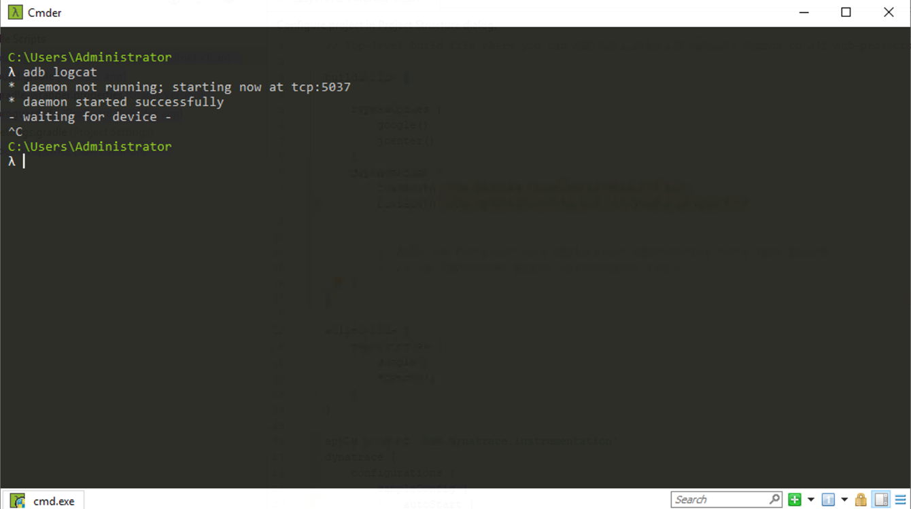
Connect Emulator Account
Mobile Monitoring Steps
Emulator Account
Build the mobile app
Define mobile app
Auto-instrument app
User tagging
Custom user actions and errors
Upload debug symbols
Open Cmder on Windows Desktop

Slide 10
Connect Emulator Account
Mobile Monitoring Steps
Emulator Account
Build the mobile app
Define mobile app
Auto-instrument app
User tagging
Custom user actions and errors
Upload debug symbols
Run the following command:
gmsaas auth login studentXXXXPerform2020@trial.dynatracelabs.com

Slide 11
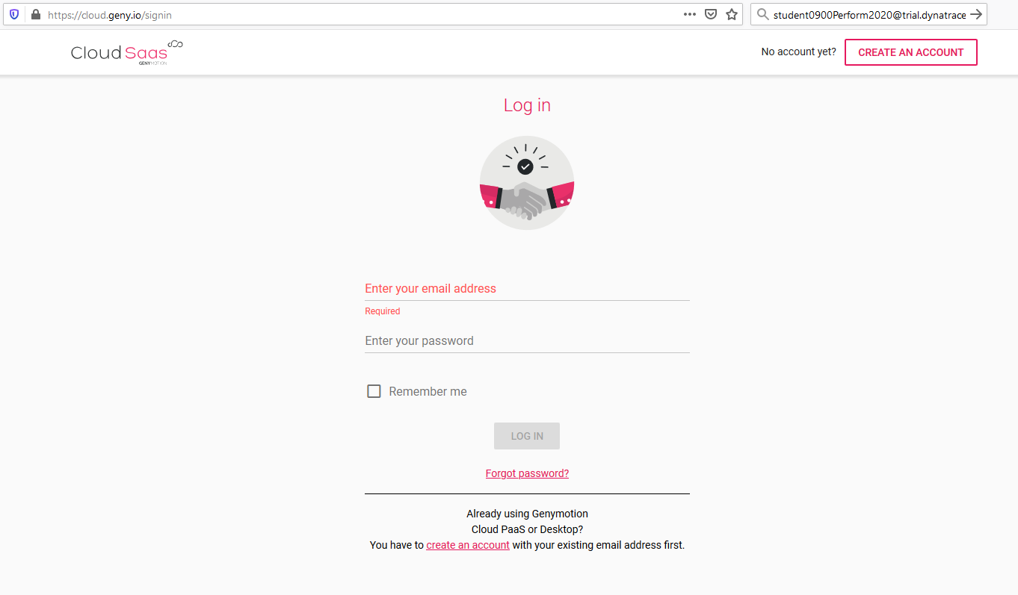
Log in to Genymotion
Mobile Monitoring Steps
Emulator Account
Build the mobile app
Define mobile app
Auto-instrument app
User tagging
Custom user actions and errors
Upload debug symbols
https://cloud.geny.io/signin

Slide 12
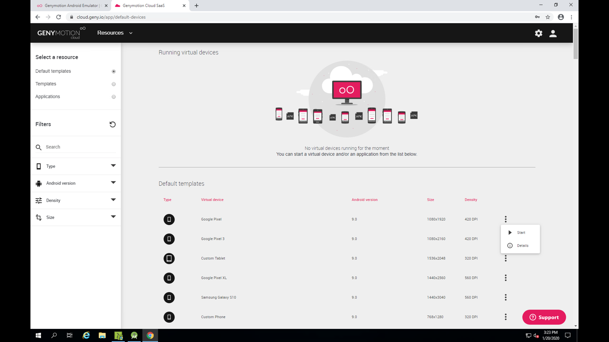
Connect Emulator Account
Mobile Monitoring Steps
Emulator Account
Build the mobile app
Define mobile app
Auto-instrument app
User tagging
Custom user actions and errors
Upload debug symbols

Slide 13
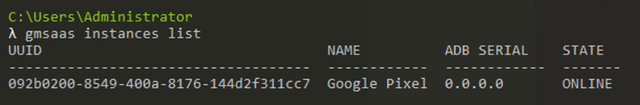
Connect Emulator Account
Mobile Monitoring Steps
Create Emulator Account
Build the mobile app
Define mobile app
Auto-instrument app
User tagging
Custom user actions and errors
Upload debug symbols
Run the following command in Cmder
gmsaas instances list
gmsaas instances adbconnect <deviceId>

Slide 14
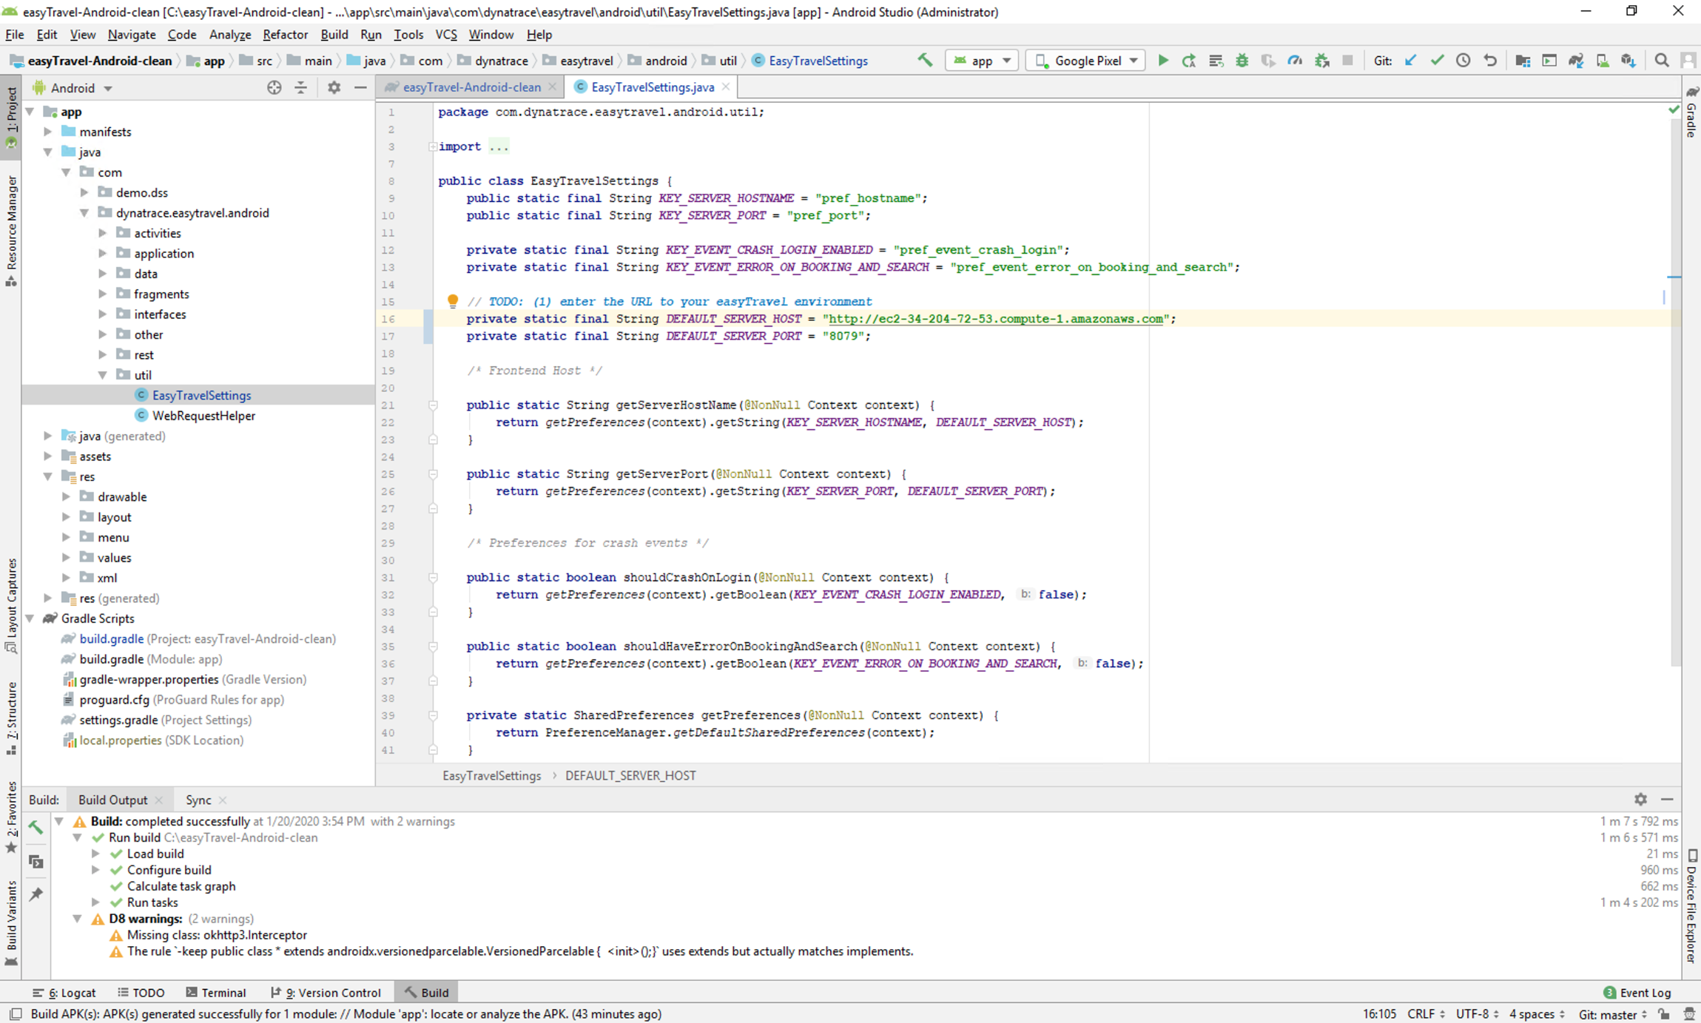
Build Mobile App
Mobile Monitoring Steps
Create Emulator Account
Build the mobile app
Define mobile app
Auto-instrument app
User tagging
Custom user actions and errors
Upload debug symbols

Slide 15
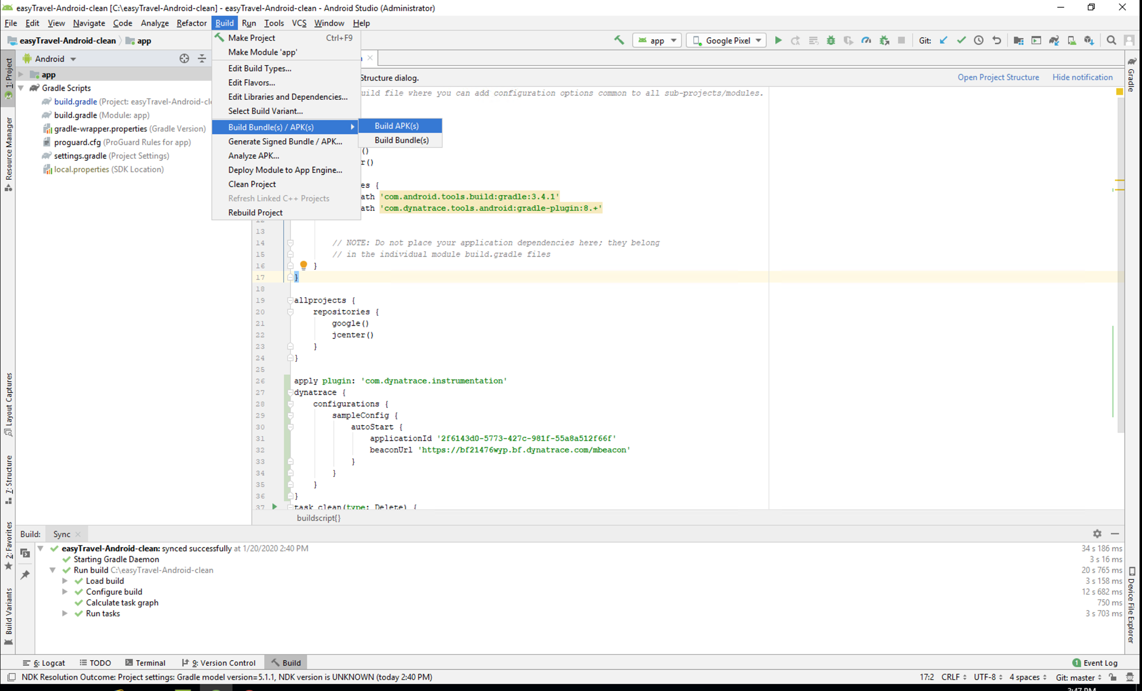
Build Mobile App
Mobile Monitoring Steps
Create Emulator Account
Build the mobile app
Define mobile app
Auto-instrument app
User tagging
Custom user actions and errors
Upload debug symbols

Slide 16
Launch Mobile App
Mobile Monitoring Steps
Create Emulator Account
Build the mobile app
Define mobile app
Auto-instrument app
User tagging
Custom user actions and errors
Upload debug symbols
Run the following command in Cmder
adb install c:\easyTravel-Android-clean\app\build\outputs\apk\dynatrace\debug\app-dynatrace-debug.apk

Slide 17
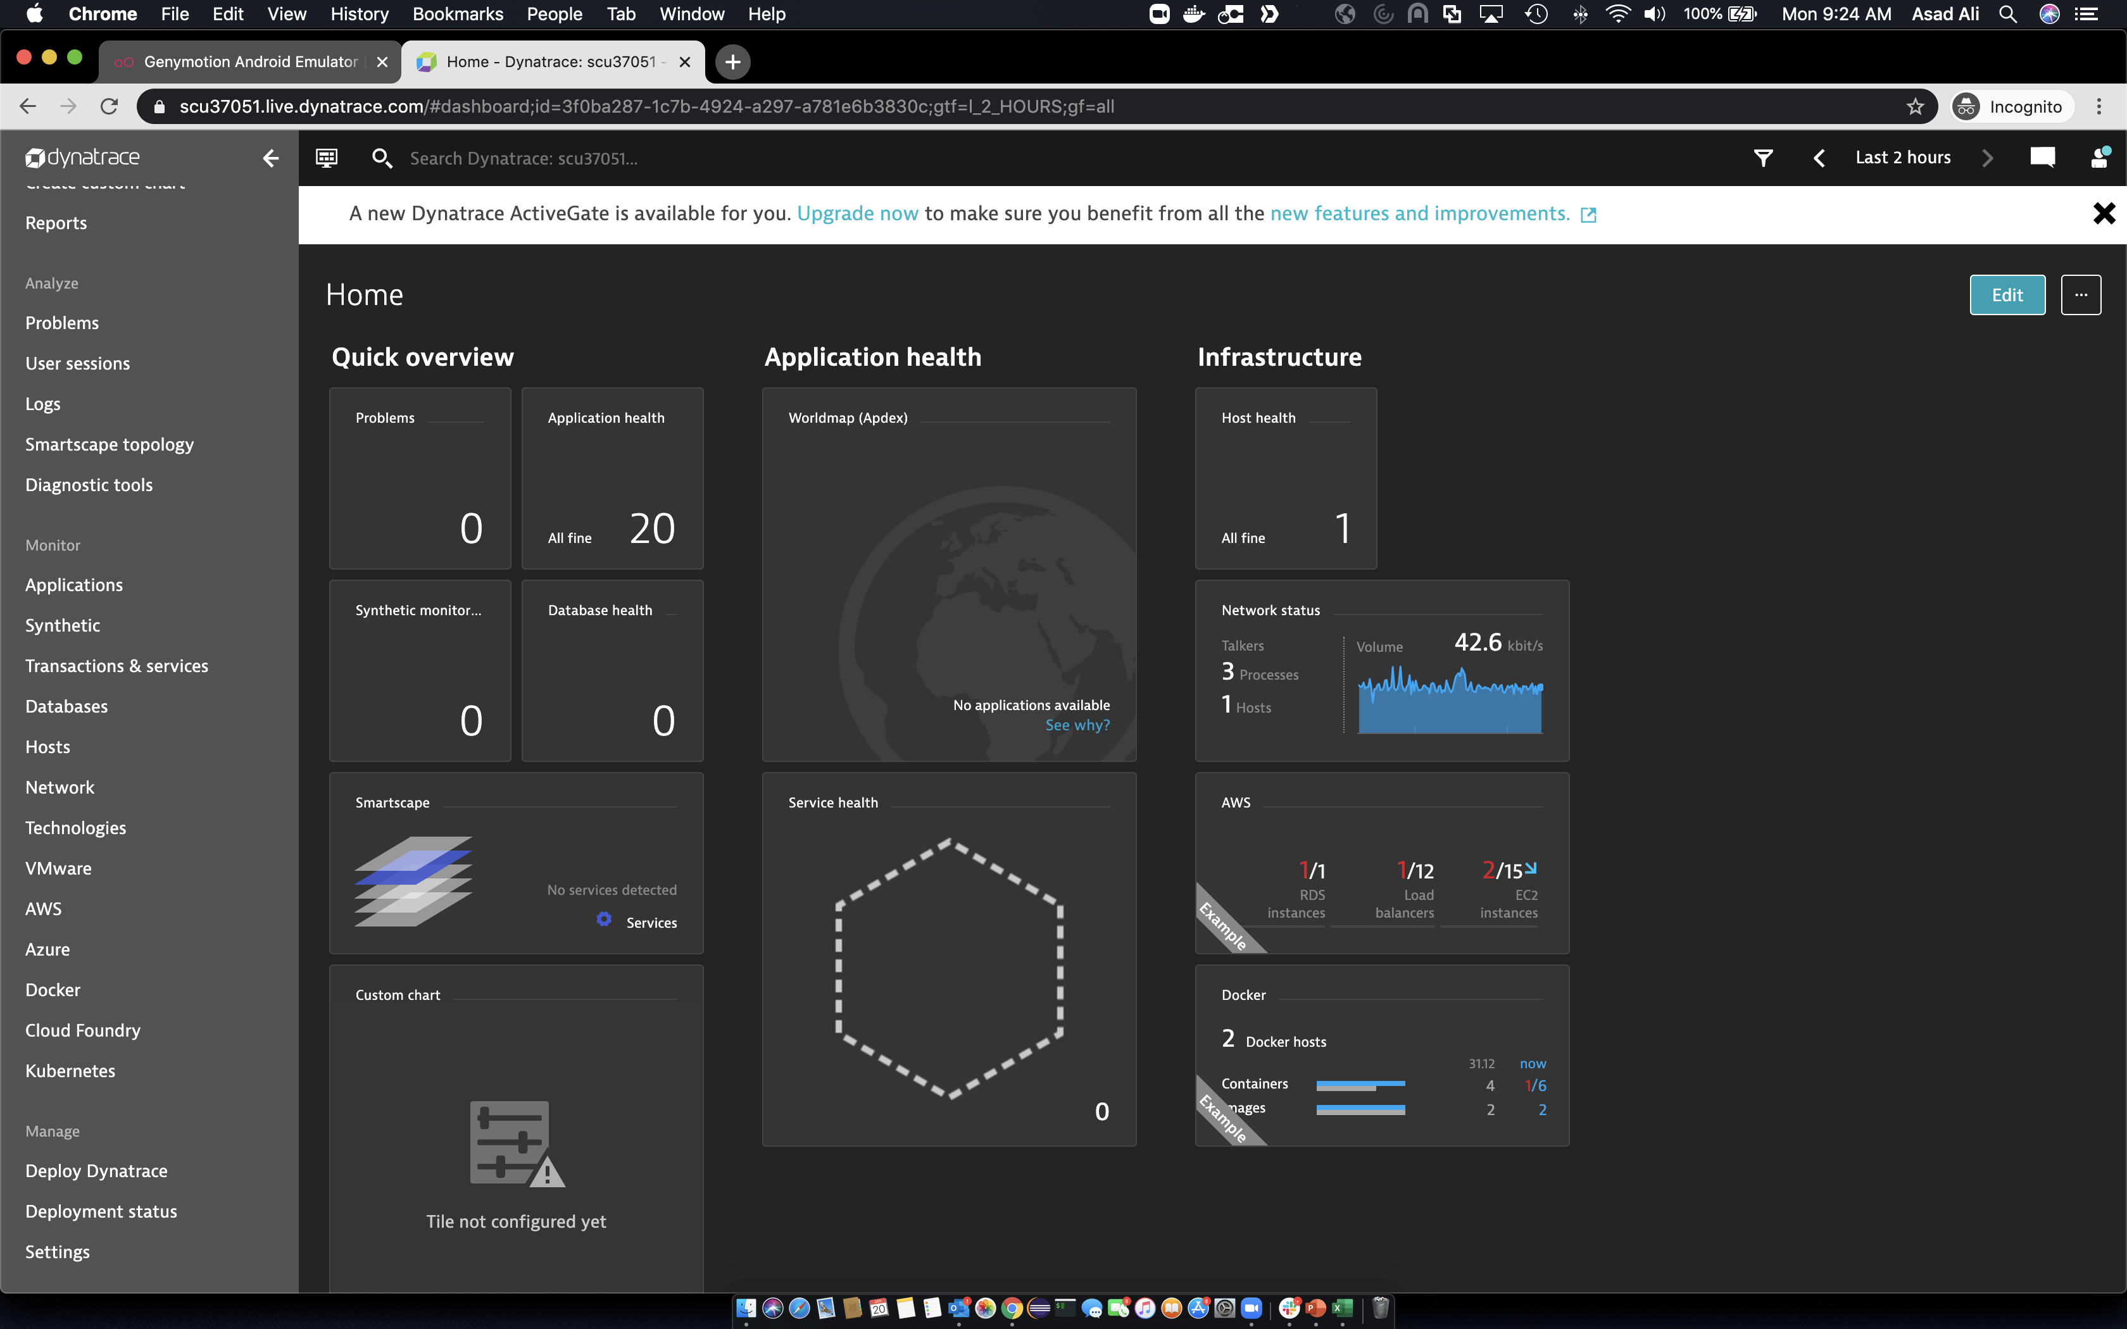
Define mobile app
Mobile Monitoring Steps
Create Emulator Account
Build the mobile app
Define mobile app
Auto-instrument app
User tagging
Custom user actions and errors
Upload debug symbols

Slide 18
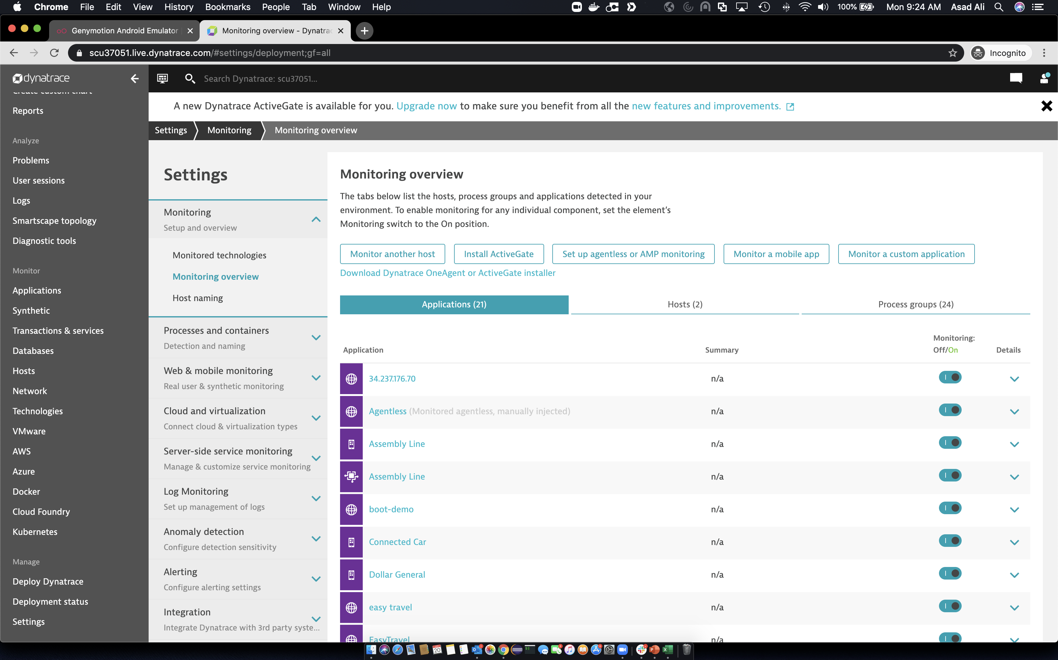
Define mobile app
Mobile Monitoring Steps
Create Emulator Account
Build the mobile app
Define mobile app
Auto-instrument app
User tagging
Custom user actions and errors
Upload debug symbols

Slide 19
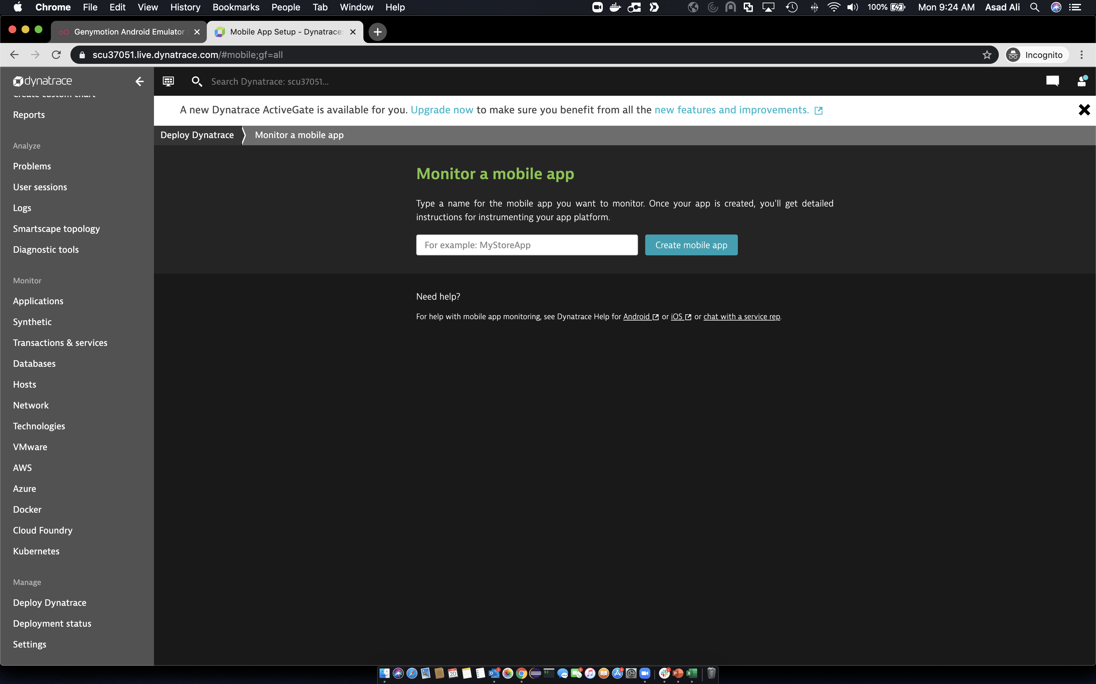
Define mobile app
Mobile Monitoring Steps
Create Emulator Account
Build the mobile app
Define mobile app
Auto-instrument app
User tagging
Custom user actions and errors
Upload debug symbols
EasyTravelMobile

Slide 20
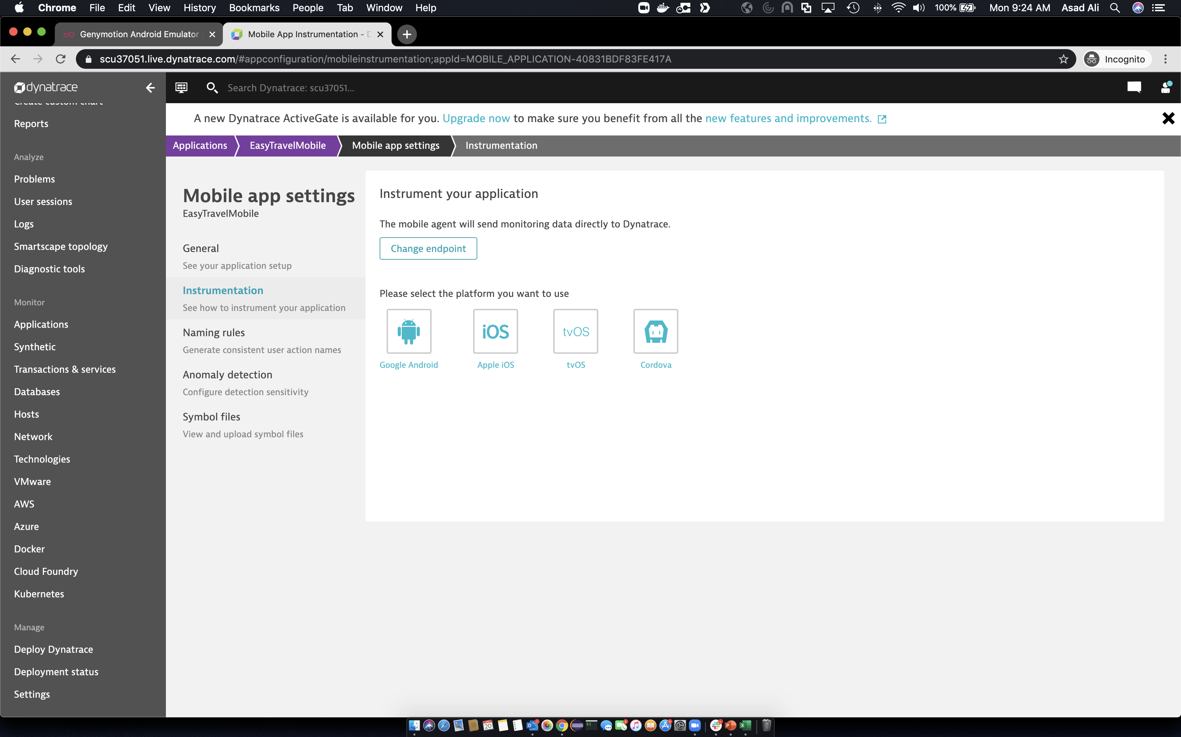
Define mobile app
Mobile Monitoring Steps
Create Emulator Account
Build the mobile app
Define mobile app
Auto-instrument app
User tagging
Custom user actions and errors
Upload debug symbols

Slide 21
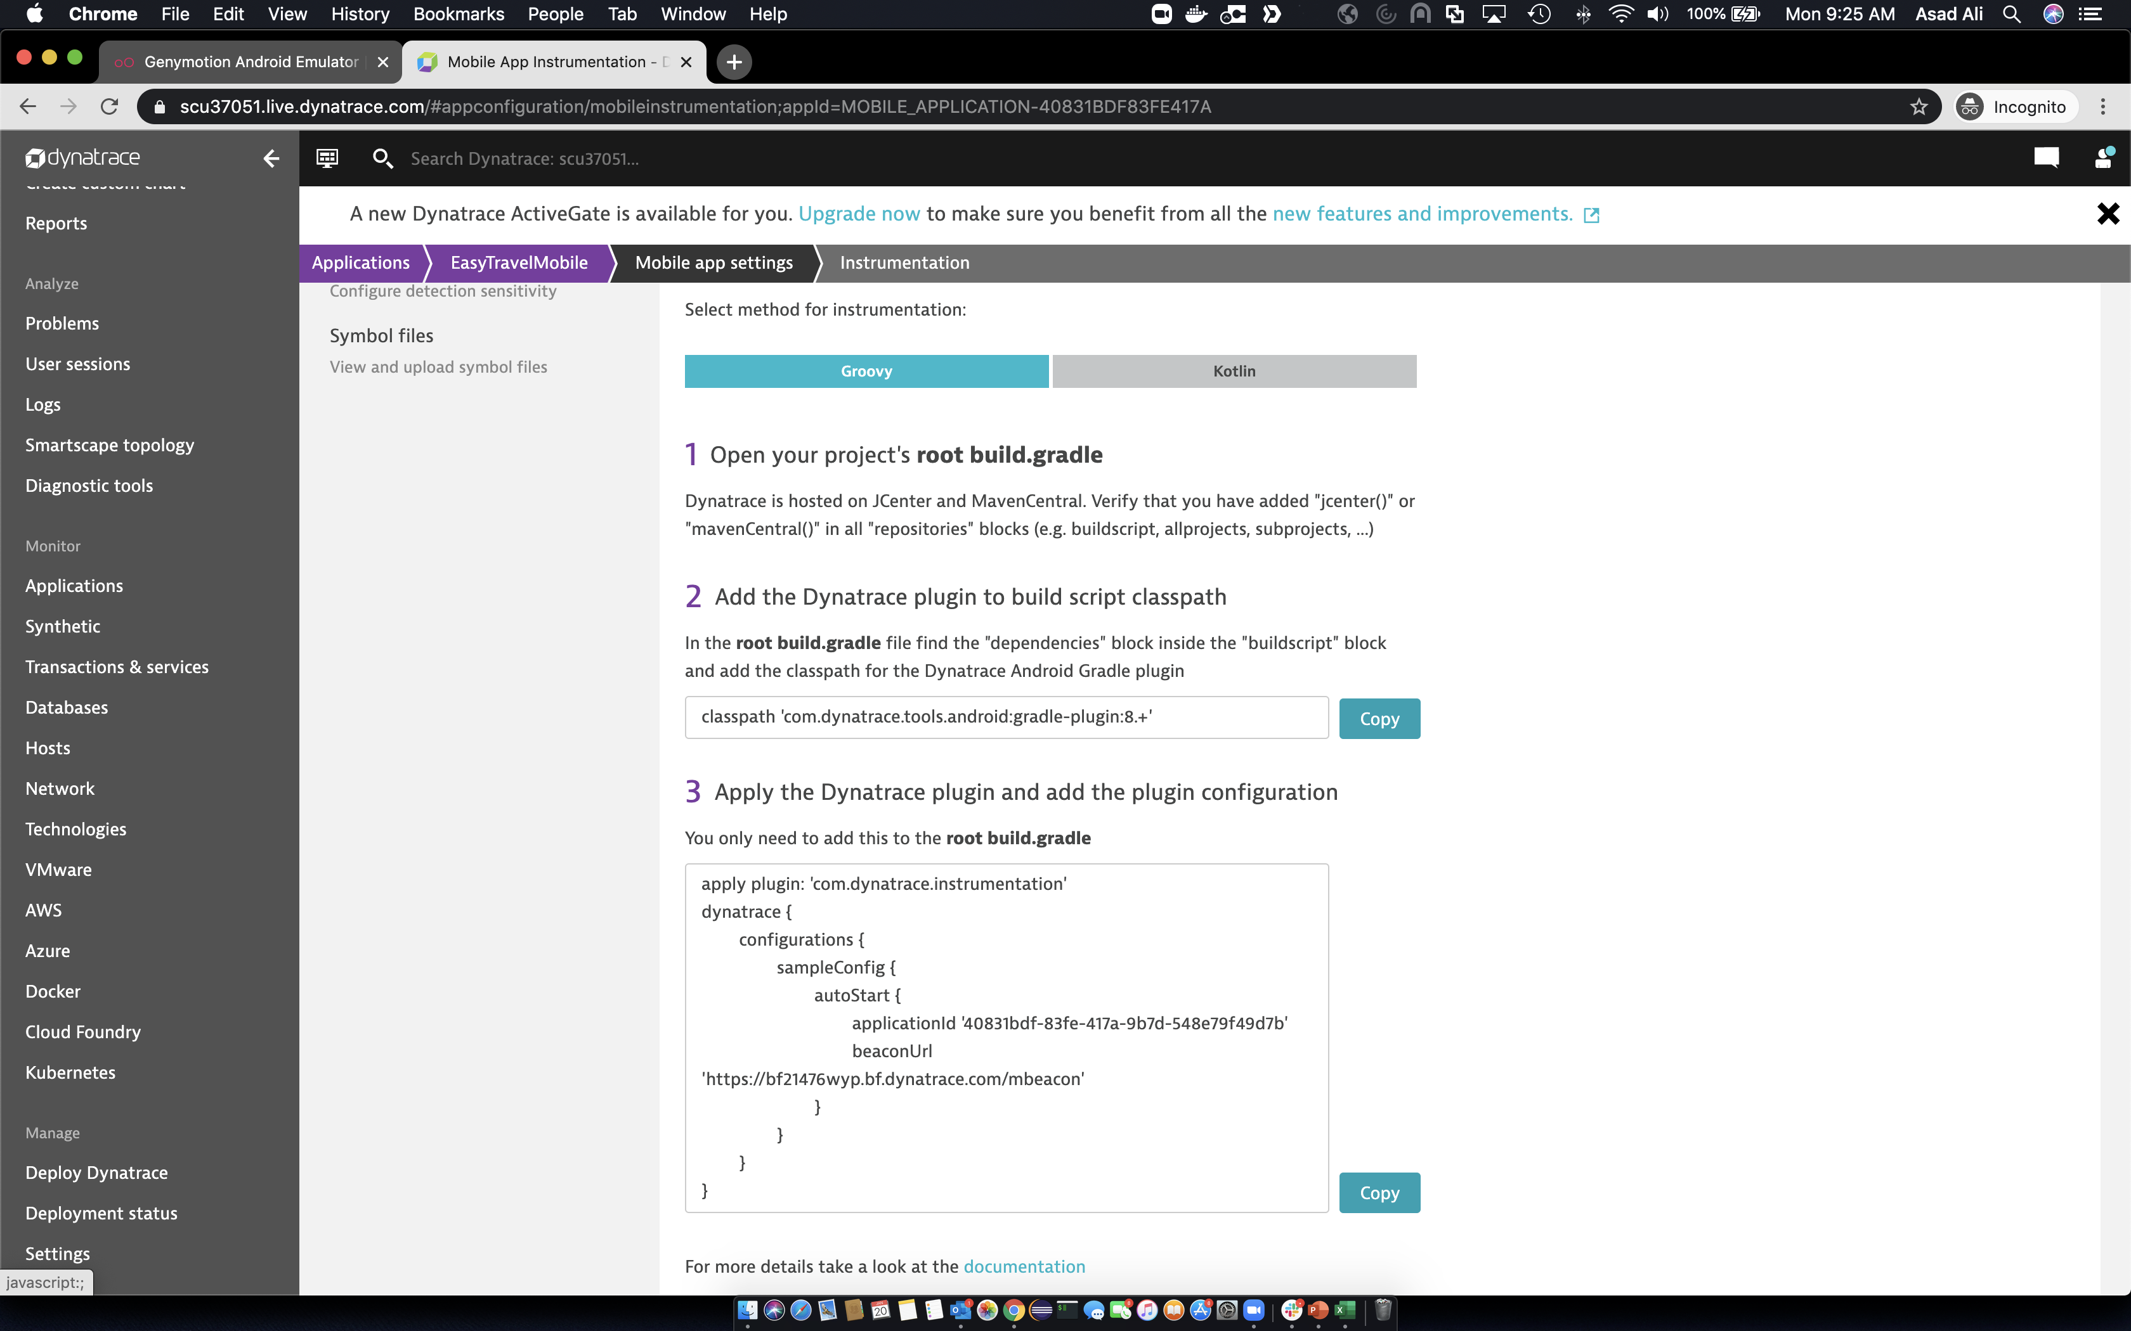
Define mobile app
Mobile Monitoring Steps
Create Emulator Account
Build the mobile app
Define mobile app
Auto-instrument app
User tagging
Custom user actions and errors
Upload debug symbols

Slide 22
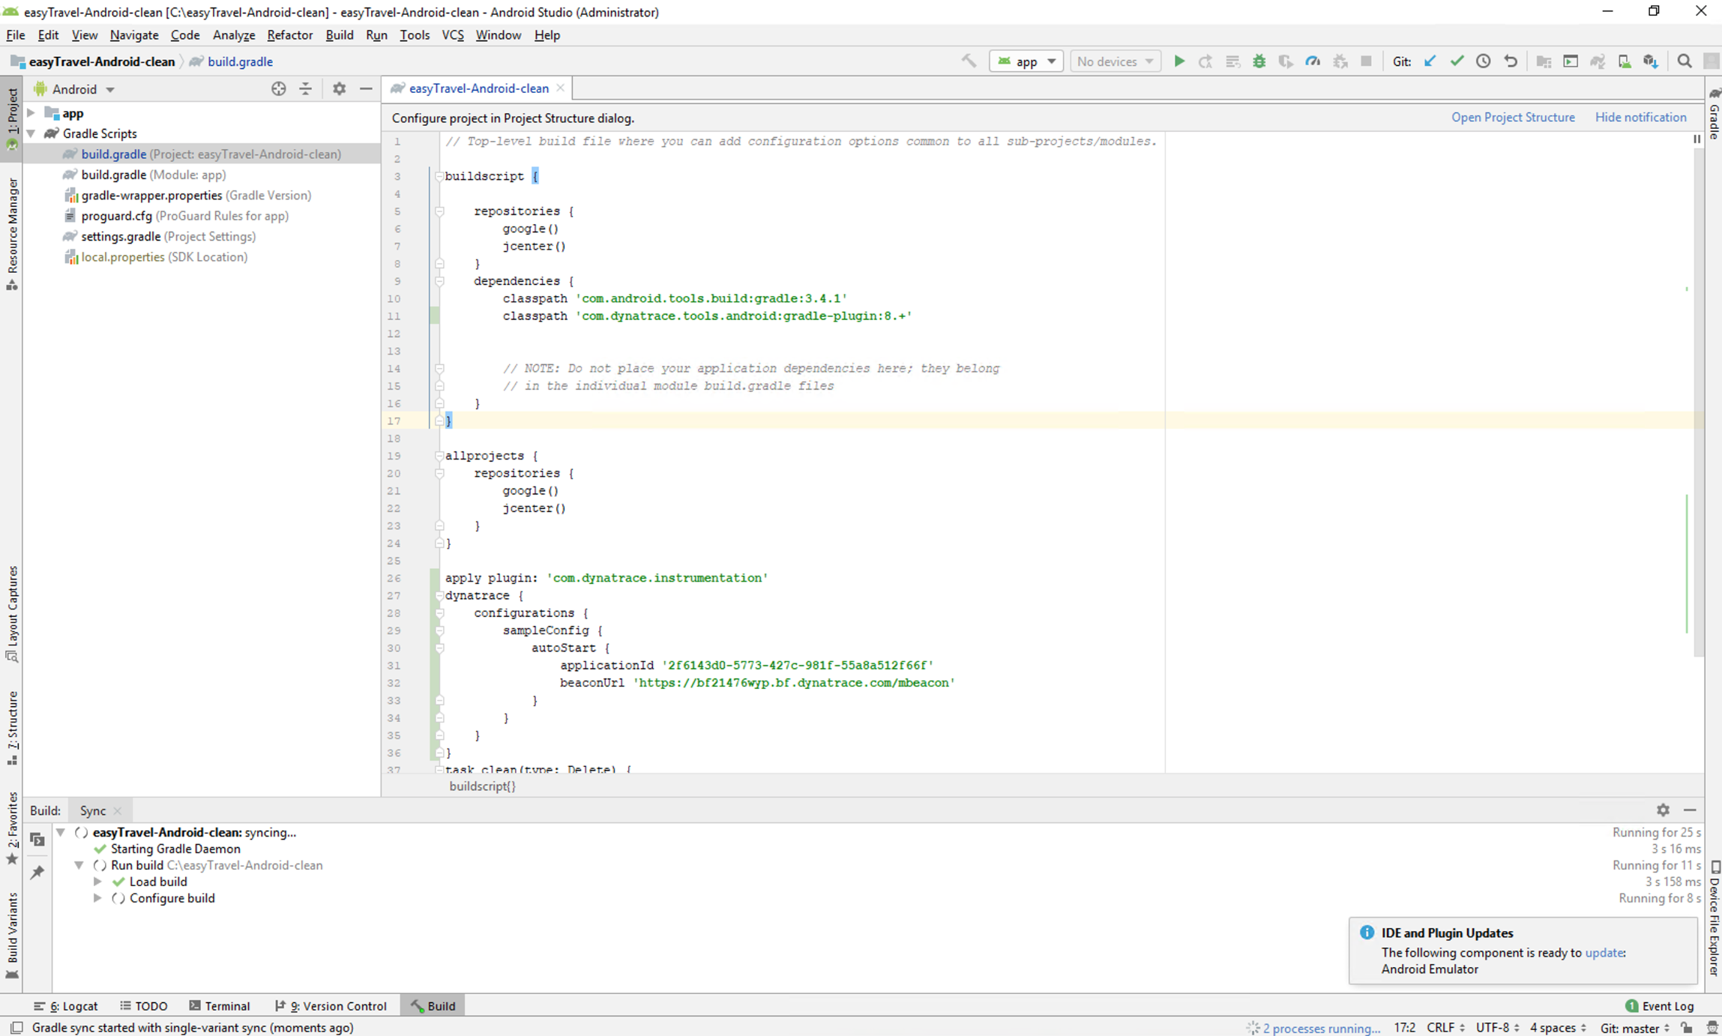
Auto Instrument App
Mobile Monitoring Steps
Create Emulator Account
Build the mobile app
Define mobile app
Auto-instrument app
User tagging
Custom user actions and errors
Upload debug symbols
Replace this section
with data from the clipboard

Slide 23
Build Mobile App
Mobile Monitoring Steps
Create Emulator Account
Build the mobile app
Define mobile app
Auto-instrument app
User tagging
Custom user actions and errors
Upload debug symbols

Slide 24
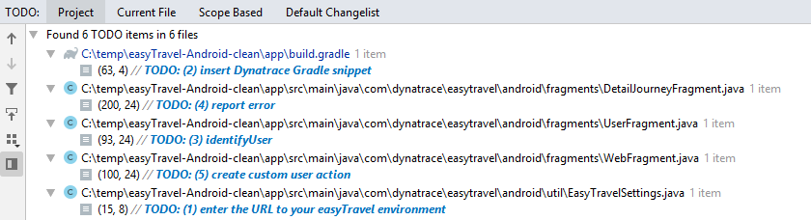
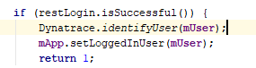
User tagging
Mobile Monitoring Steps
Create Emulator Account
Build the mobile app
Define mobile app
Auto-instrument app
User tagging
Custom user actions and errors
Upload debug symbols
Notes:
Review user sessions

Slide 25
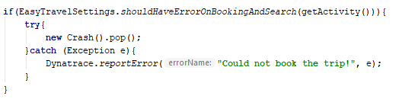
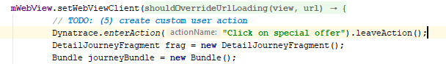
Custom user actions and errors
Mobile Monitoring Steps
Create Emulator Account
Build the mobile app
Define mobile app
Auto-instrument app
User tagging
Custom user actions and errors
Upload debug symbols
Notes:
Review MDA – errors, web requests, etc...

Slide 26
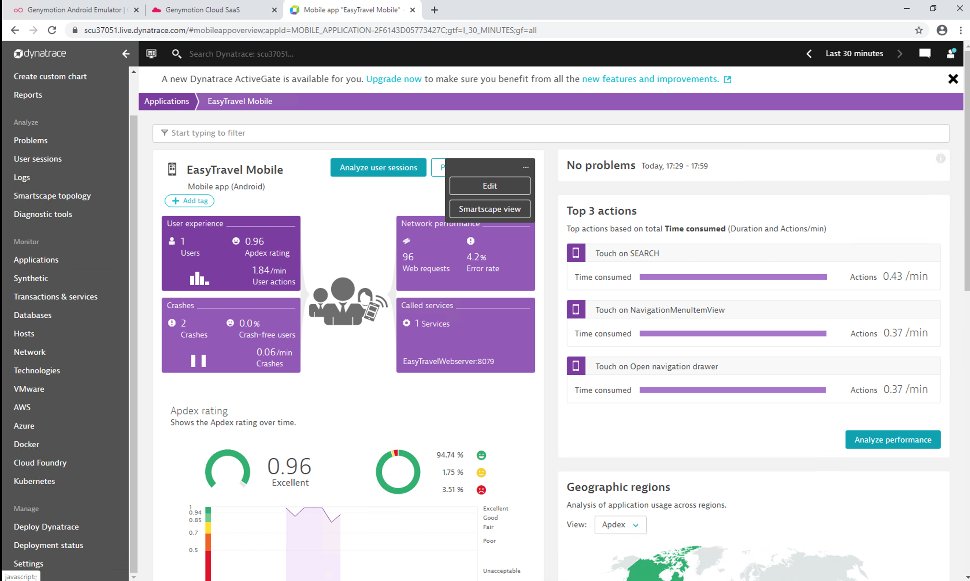
Custom user actions and errors
Mobile Monitoring Steps
Define mobile app
Auto-instrument app
Create Emulator Account
Build the mobile app
User tagging
Custom user actions and errors
Upload debug symbols
Notes:
Review crashes in appoverview

Slide 27
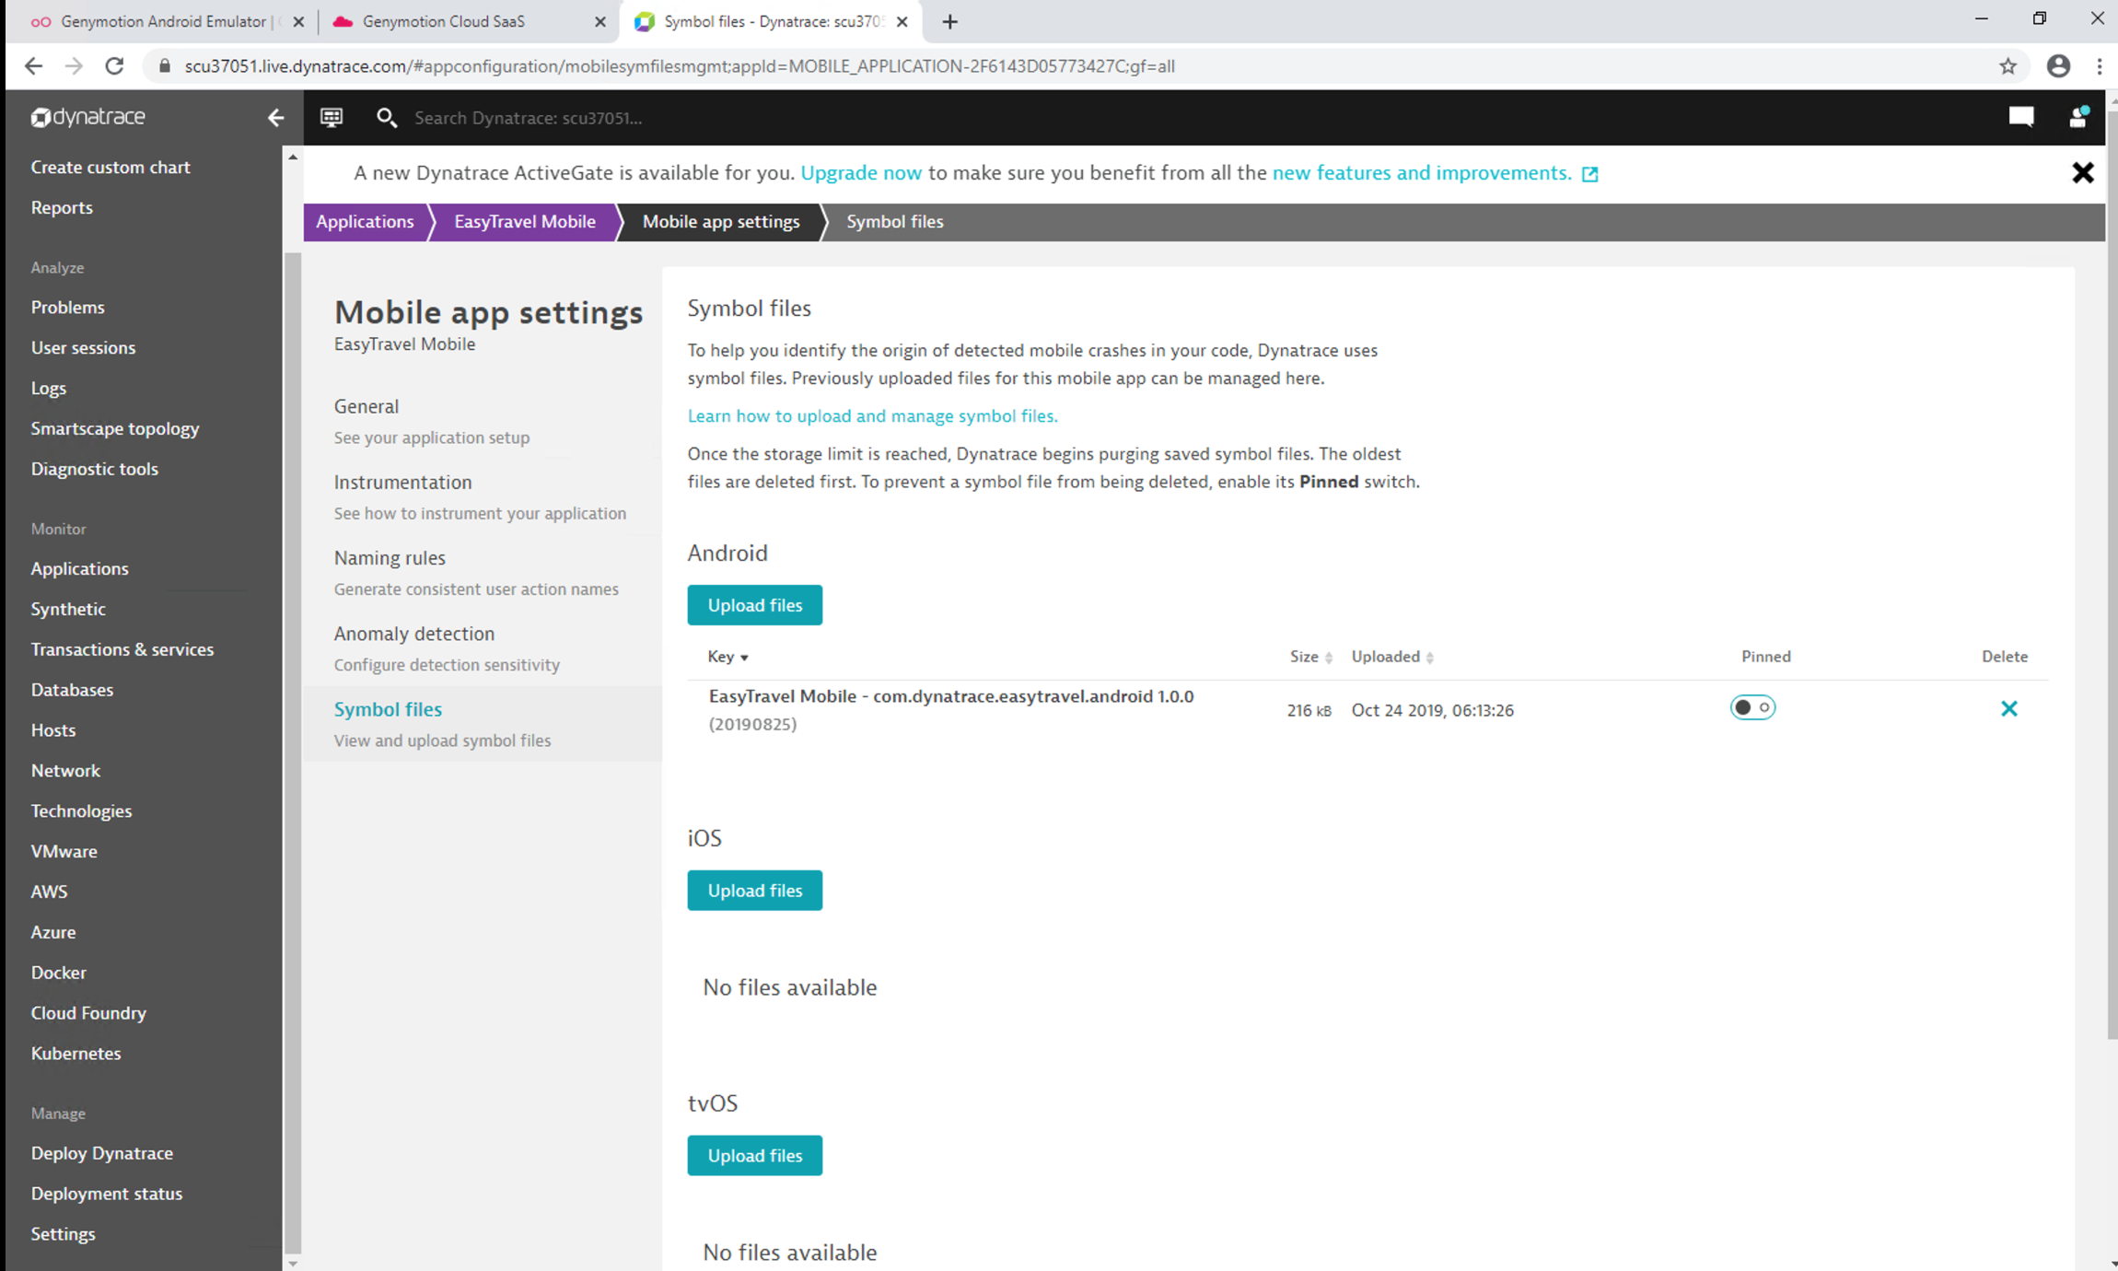
Custom user actions and errors
Mobile Monitoring Steps
Create Emulator Account
Build the mobile app
Define mobile app
Auto-instrument app
User tagging
Custom user actions and errors
Upload debug symbols
Notes:
Review crashes in appoverview

Slide 28
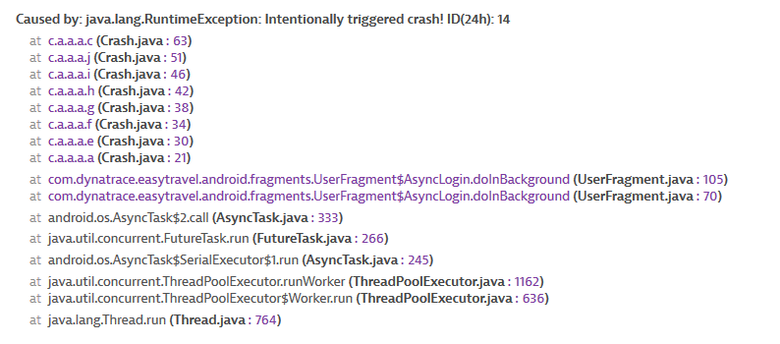
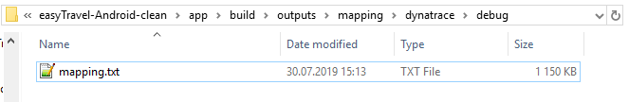
Upload Debug Symbols
Mobile Monitoring Steps
Create Emulator Account
Build the mobile app
Define mobile app
Auto-instrument app
User tagging
Custom user actions and errors
Upload debug symbols
Notes:
Review crashes in appoverview

Slide 29
#2 Mobile app analytics

Slide 30
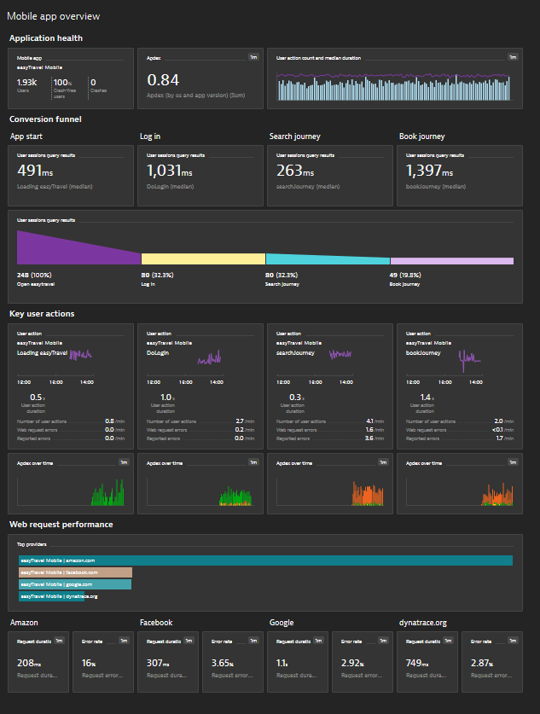
Let‘s build a mobile app overview dashboard
Mobile app metrics
USQL
Key user actions
Web request metrics

Slide 31
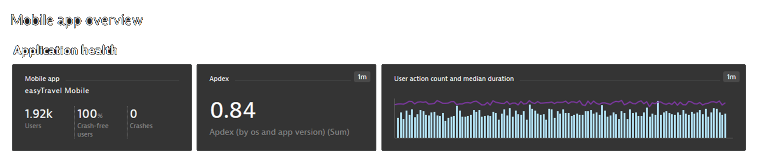
Create a new dashboard
Use the following tiles
Header
Mobile app
Custom chart – Single value - Apdex (by OS and app version)
Custom chart – Timeseries – Action duration and action count

Slide 32
Summary application overview & mobile app metrics
Mobile app tile can be selected from the tile catalog or you can pin it to the dashboard from the app overview
Metrics for custom charting are available out-of-the box
Application -> Mobile & custom -> <metric name>
All metrics can be split by OS family (iOS, tvOS, Android)
Other dimensions involve
Geo location
App version
Apdex category

Slide 33
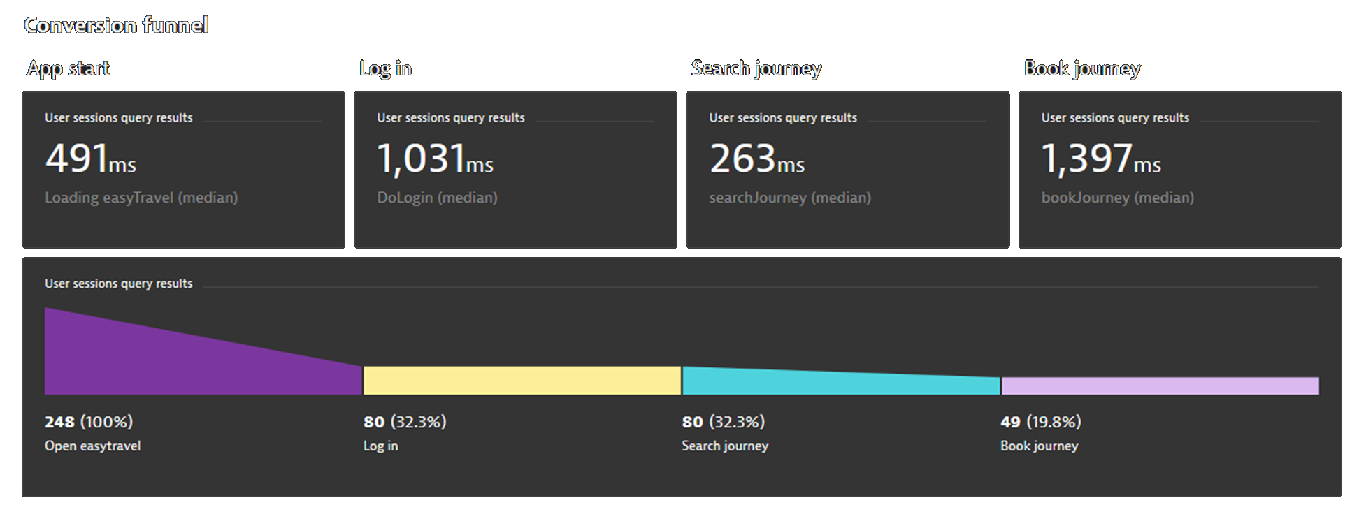
Focus on the following 4 user actions
Loading easyTravel
DoLogin
searchJourney
bookJourney
Use USQL to create the following tiles
4x median user action duration
1x funnel
Notes:
SELECT FUNNEL(
useraction.name="Loading easyTravel" AS "Open easytravel",
useraction.name = "DoLogin" AS "Log in",
useraction.name = "searchJourney" AS "Search journey",
useraction.name = "bookJourney" AS "Book journey„
) FROM usersession
SELECT MEDIAN(duration) as "Loading easyTravel (median)" FROM useraction
WHERE application="easyTravel Mobile" AND name="Loading easyTravel“

Slide 34
Summary USQL
User sessions -> User sessions query
Data comes out of elastic search
Some limitation around elastic search
Data retention 35 days
Potential read sampling
Follow these steps
Build a query
Run it
Select chart type
Pin to dashboard

Slide 35



Key user actions
Dashboarding
APDEX Threshold
DAVIS
Notes:
Dashboarding
Foundation for dashboarding is to have data stored as metrics in Dynatrace
Metrics are available forever, in contrast to standardized on-demand analysis (long term trending)
→ Pin to dashboard
→ User action metrics for custom charting
APDEX
Define individual thresholds for every key user action (e.g. 16 sec.)
Configure if errors are used for APDEX
Normalizes performance and errors across different thresholds
Allows to have a single measure that shows the state of your application
DAVIS support
Dynatrace automatically tracks user action duration, throughput and reported errors
Calculates a baseline and generates alerts, once they are violated

Slide 36
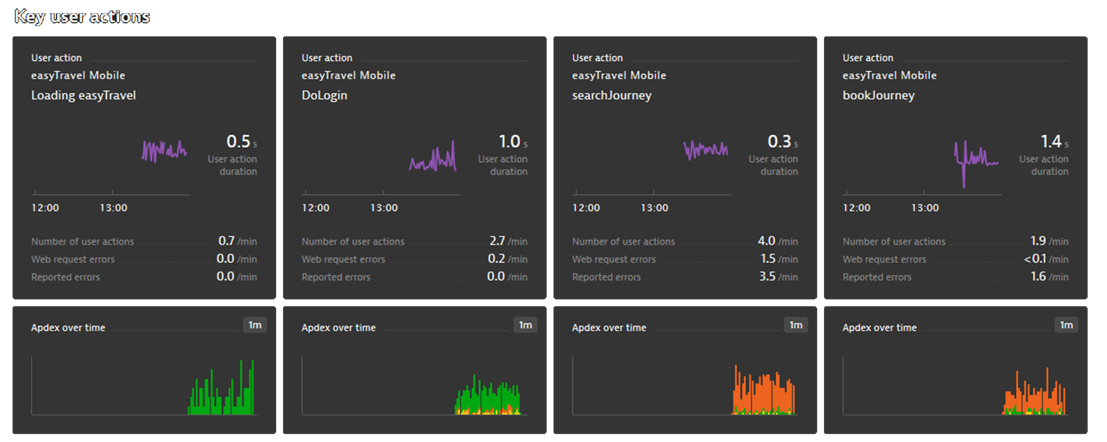
Take a look at the multi dimensional analysis screen
Mark the following 4 key user actions
Loading easyTravel
DoLogin
searchJourney
bookJourney
Pin the key user action tile to your dashboard
Create a custom chart for every key user action showing User action count split by apdex category

Slide 37
Summary key user actions
Multi dimensional analysis shows data based on code level storage
Data retention 35 days
Ad-hoc analysis
Different breakdown charts
Web requests and errors over time
Key user actions will be stored as metrics
Data retention forever
Application -> Mobile & custom -> Mobile app key user actions -> <metric name>
All metrics can be split by OS family (iOS, tvOS, Android)
Good way to find the right threshold is to look at the user action duration distribution chart in the multidimensional analysis

Slide 38
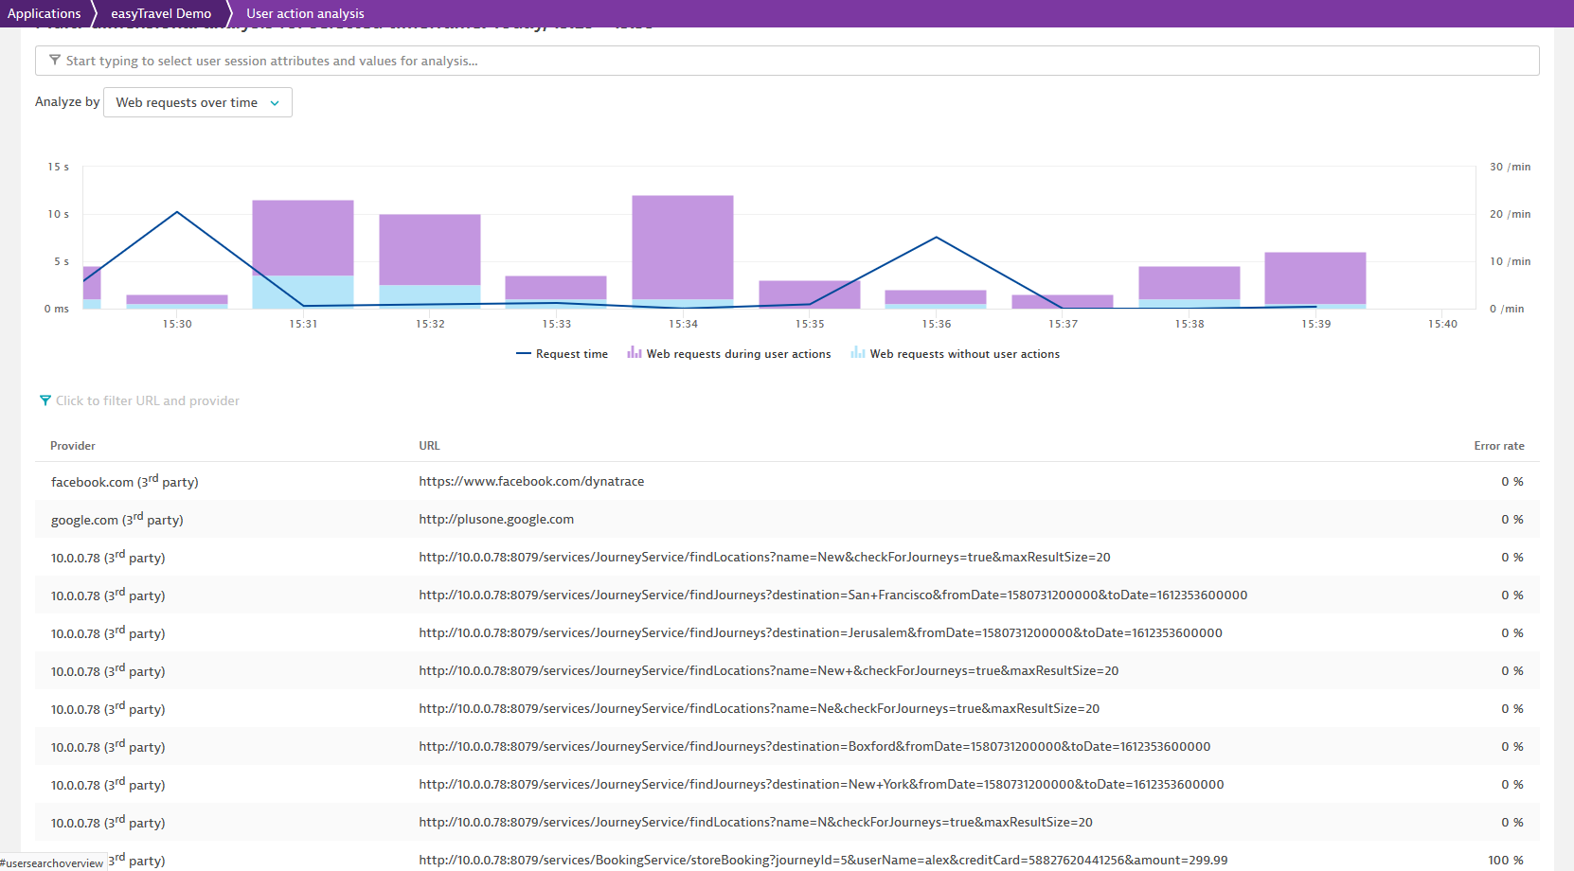
During or outside of user actions?
Clean up URLs
First party

Slide 39
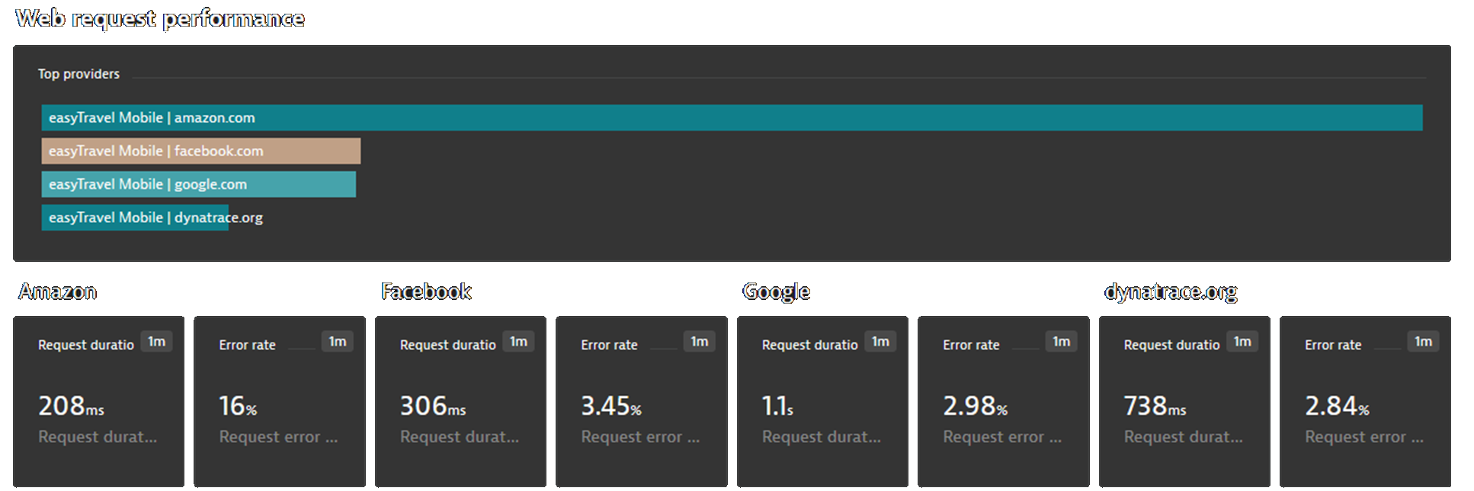
See what Dynatrace stores about web requests
Learn how you can configure web request capturing in Dynatrace
Use the following tiles
Custom chart – top list – request count by provider
Custom chart – single value – request duration and request error rate

Slide 40
Summary web request monitoring
Web requests are captured automatically by the mobile agent
Automatically grouped into providers based on top level domain
Configuration to change the provider groups
Configuration to clean up parts of the URL
Web request metrics on application level can be split by provider

Slide 41
#3 Instrumenting a React Native app

Slide 42
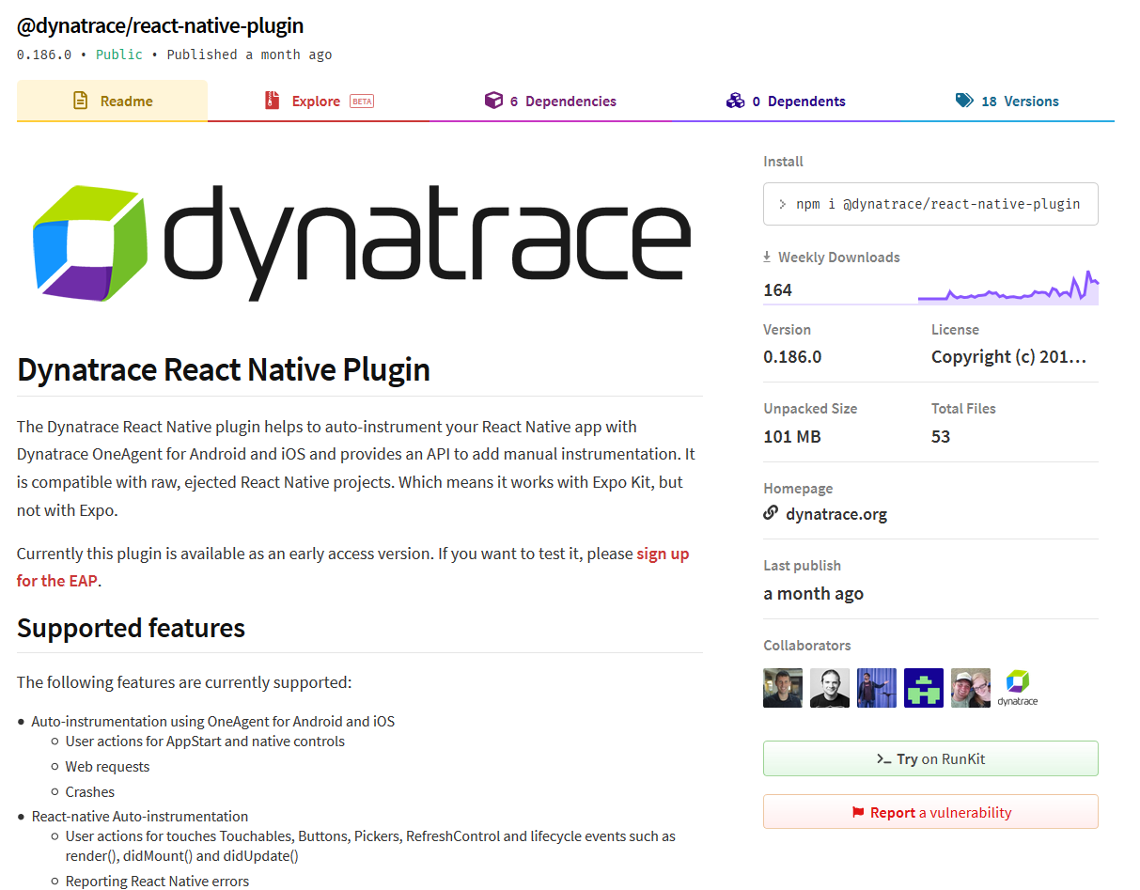

Slide 43
Download the app
Mobile Monitoring Steps
Build the app
Install & run the app
Instrument the app
User tagging
Custom user actions and errors
Run the following command in Cmder
cd perform-2020-hotday\hotday_mobileapps\TheMovieRater\
setup
npm install

Slide 44
Connect Emulator Account
Mobile Monitoring Steps
Build the app
Install & run the app
Instrument the app
User tagging
Custom user actions and errors
Run the following command in Cmder
cd android
build

Slide 45
Connect Emulator Account
Mobile Monitoring Steps
Build the app
Install & run the app
Instrument the app
User tagging
Custom user actions and errors
Run the following command in Cmder
gmsaas instances list
gmsaas instances adbconnect <deviceId>

Slide 46
Connect Emulator Account
Mobile Monitoring Steps
Build the app
Install & run the app
Instrument the app
User tagging
Custom user actions and errors
Run the following command in Cmder
install

Slide 47
Connect Emulator Account
Mobile Monitoring Steps
Build the app
Install & run the app
Instrument the app
User tagging
Custom user actions and errors
Run the app in the simulator
login: mobile
pass: react-native

Slide 48
Connect Emulator Account
Mobile Monitoring Steps
Build the app
Install & run the app
Instrument the app
User tagging
Custom user actions and errors
cd ..
Review the notes file

Slide 49
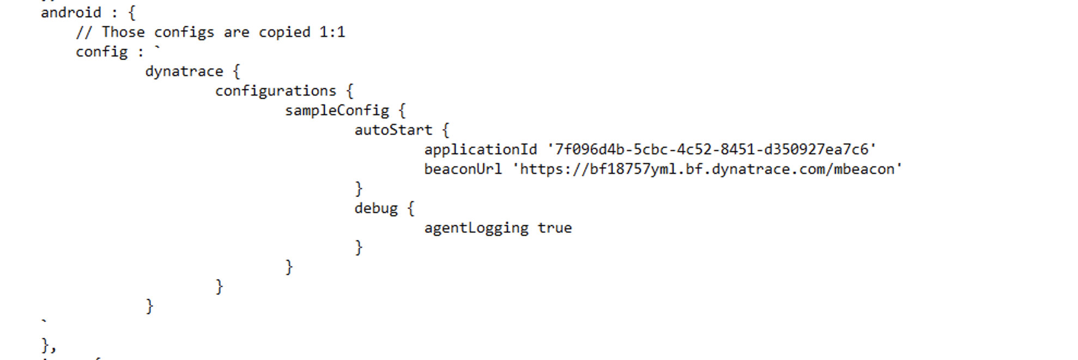
Mobile Monitoring Steps
dynatrace.config.js

Slide 50
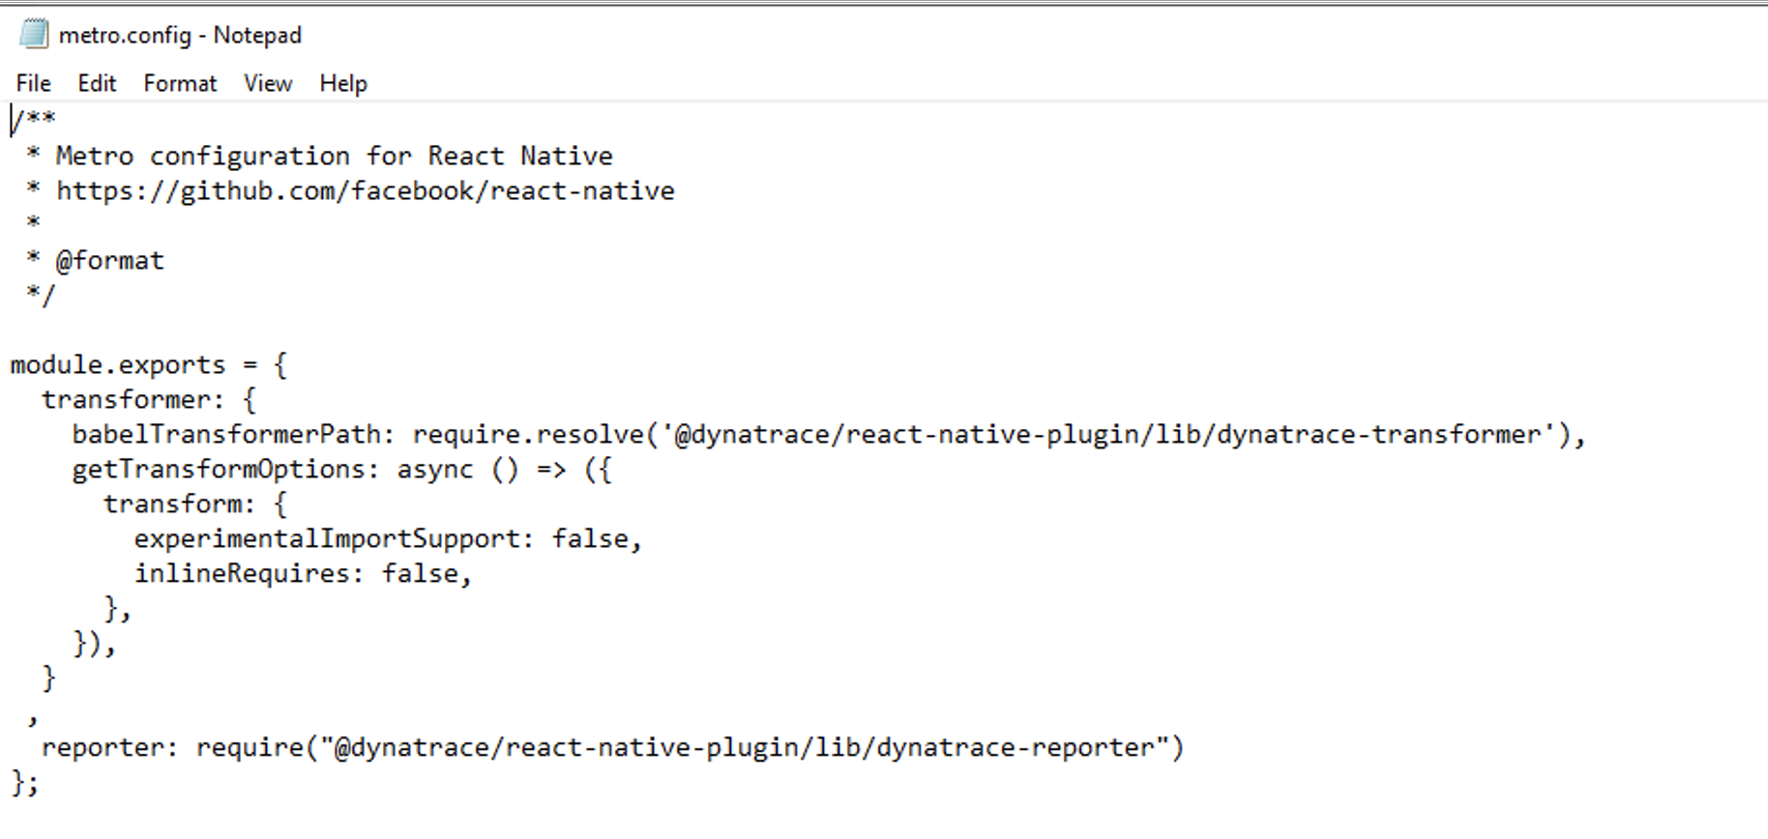
Mobile Monitoring Steps
dynatrace.config
metro.config.js

Slide 51
Connect Emulator Account
Mobile Monitoring Steps
Build the app
Install & run the app
Instrument the app
User tagging
Custom user actions and errors
npm run instrumentDynatrace
cd android
build

Slide 52
Connect Emulator Account
Mobile Monitoring Steps
Build the app
Install & run the app
Instrument the app
User tagging
Custom user actions and errors
Run the following command in Cmder
gmsaas instances list
gmsaas instances adbconnect <deviceId>

Slide 53
Connect Emulator Account
Mobile Monitoring Steps
Build the app
Install & run the app
Instrument the app
User tagging
Custom user actions and errors
Run the following command in Cmder
install

Slide 54
Connect Emulator Account
Mobile Monitoring Steps
Build the app
Install & run the app
Instrument the app
User tagging
Custom user actions and errors
Run the app in the simulator
Analyze the data in Dynatrace UI

Slide 55
Connect Emulator Account
Mobile Monitoring Steps
Build the app
Install & run the app
Instrument the app
User tagging
Custom user actions and errors
Edit components/auth.js

Slide 56
Connect Emulator Account
Mobile Monitoring Steps
Build the app
Install & run the app
Instrument the app
User tagging
Custom user actions and errors
Edit components/details.js

Slide 57
Mobile monitoring @ Perform 2020
Wednesday
→ Come and visit us at the Innovation Expo Center
Thursday
9:30 – 9:50 Mainstage – Steve Tack‘s Product feature
12:00 – 12:45 Breakout – How KBC does mobile app monitoring
2:00 – 2:45 Breakout – Digital experience management roadmap

Slide 58
Thank you

